Slide 1




MODE multimodal methodologies
FOR RESEARCHING DIGITAL DATA AND ENVIRONMENTS
Exploring Different Approaches to Multimodal Transcription
Kate Cowan & Myrrh Domingo
k.cowan@ioe.ac.uk
m.domingo@ioe.ac.uk
http://mode.ioe.ac.uk

Slide 2
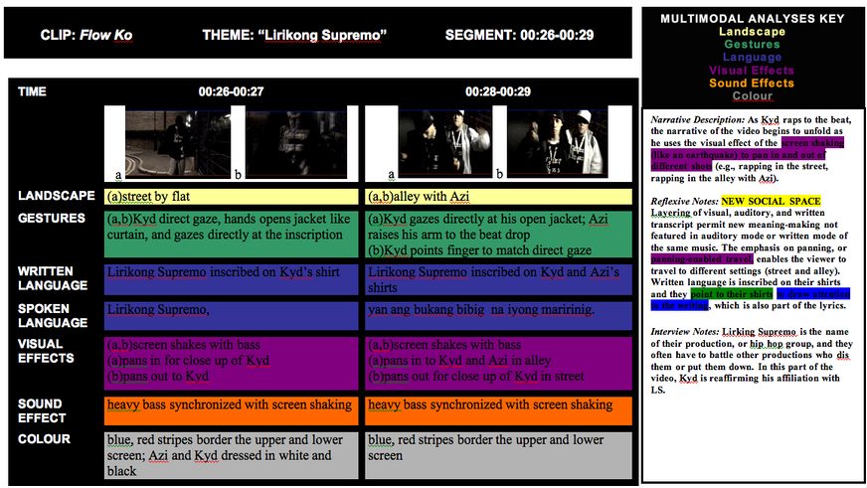
Domingo, M. (2011) Analyzing layering in textual design: a multimodal approach for examining cultural, linguistic, and social migrations in digital video. International Journal of Social Research Methodology, 14 (3): 219–230.

Slide 3
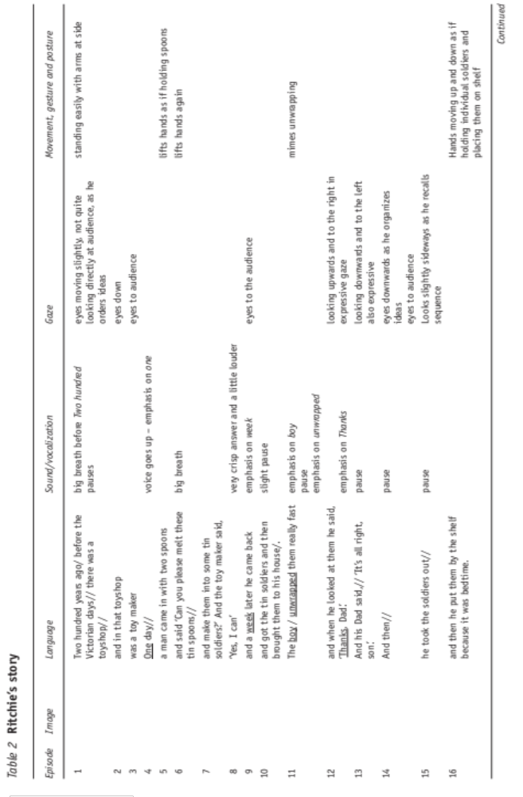
Bearne, E. (2009). Multimodality, literacy and texts: Developing a discourse. Journal of Early Childhood Literacy 9 (2) 156-187

Slide 4
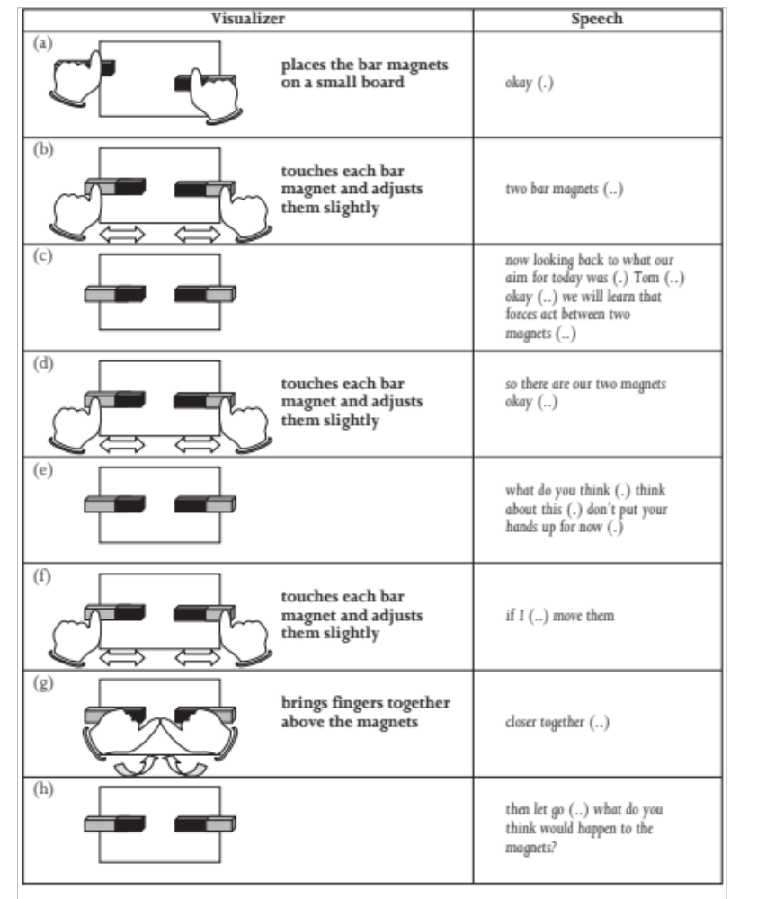
Mavers, M. (2009). Student text-making as semiotic work. Journal of Early Childhood Literacy 9 (2) 141-155

Slide 5
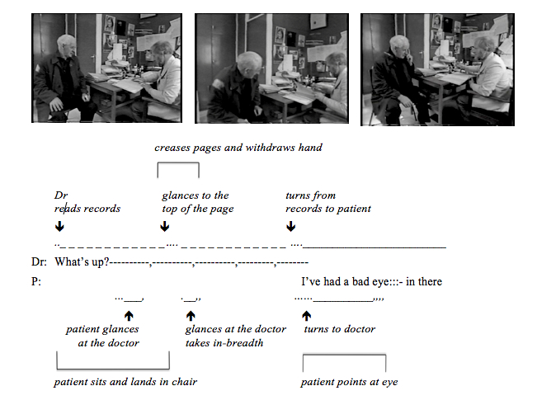
Heath, C., Hindmarsh, J. and Luff, P. (2010) Video in Qualitative Research: Analysing Social Interaction in Everyday Life. London: Sage.

Slide 6
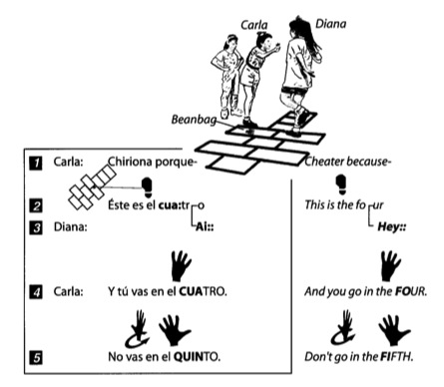
Goodwin, C. (2000) Action and embodiment within situated human interaction. Journal of Pragmatics, 32, 1489-1522.

Slide 7
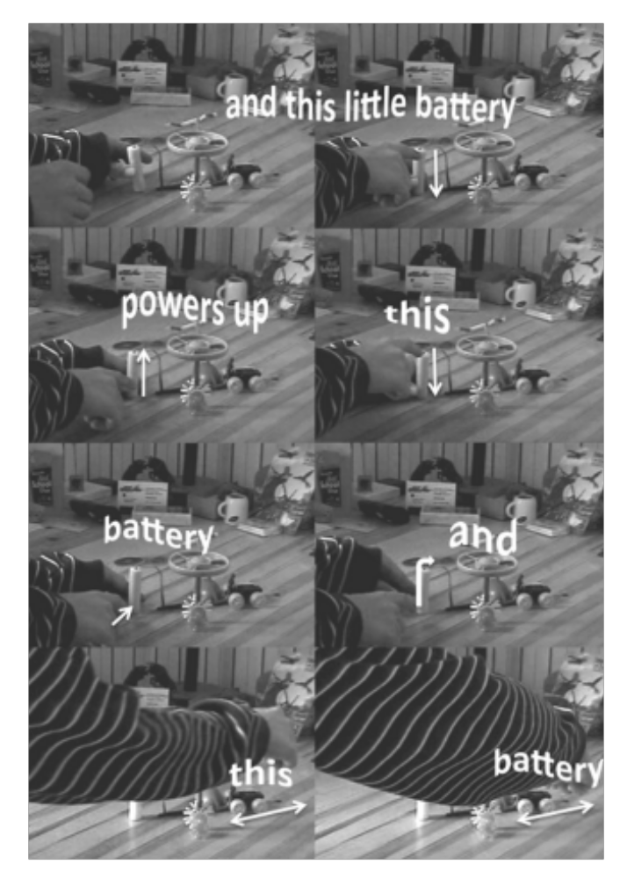
Norris, S. (2011).Three hierarchical positions of deictic gesture in relation to spoken language: a multimodal interaction analysis. Visual Communication 10 129-147

Slide 8
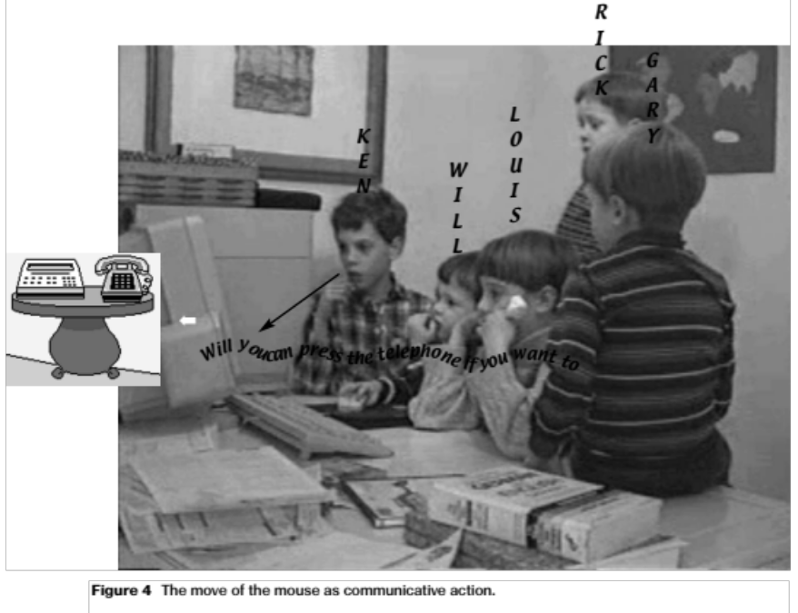
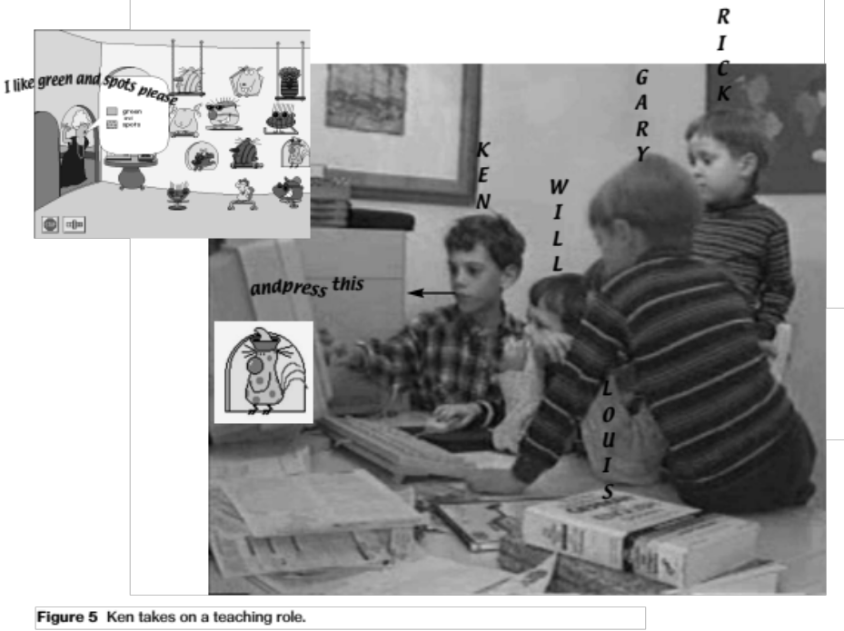
Norris, S. (2002) The implication of visual research for discourse analysis: transcription beyond language. Visual Communication, 1, 97 – 121.

Slide 9
MODE multimodal methodologies
FOR RESEARCHING DIGITAL DATA AND ENVIRONMENTS
Comparing Transcripts
Which modes of the original interaction are transcribed?
Which modes are used for transcribing?
What layout is used?
How do these choices reshape the original interaction, and what is the effect?

Slide 10
k.cowan@ioe.ac.uk
m.domingo@ioe.ac.uk
http://mode.ioe.ac.uk/category/transcription-bank

